Slide 1
Predictive Analysis Models

Slide 2
Linear Models

Slide 3
Linear Models
The most basic type of models in analytics
“Linear” means the relationship between the input features and the output target is modeled as being linear
In Regression, this means the prediction of the target being a straight line in terms of the single input
The linear model in regression is called Linear Regression and classification Logistic Regression
GPA
GPA
Study Time
Study Time
Linear Relationship
Nonlinear Relationship

Slide 4

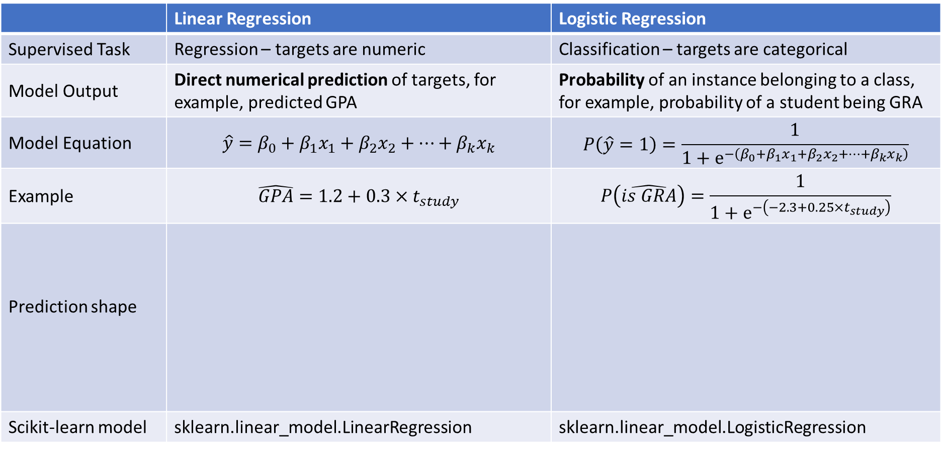



Linear Regression and Logistic Regression
 | Linear Regression | Logistic Regression
Supervised Task | Regression – targets are numeric | Classification – targets are categorical
Model Output | Direct numerical prediction of targets, for example, predicted GPA | Probability of an instance belonging to a class, for example, probability of a student being GRA
Model Equation | $$\hat{y}=β_{0}+β_{1}x_{1}+β_{2}x_{2}+…+β_{k}x_{k}$$ | $$P\left(\hat{y}=1\right)=\frac{1}{1+e^{−\left(β_{0}+β_{1}x_{1}+β_{2}x_{2}+…+β_{k}x_{k}\right)}}$$
Example | $$\hat{GPA}=1.2+0.3×t_{study}$$ | $$P\left(\hat{is GRA}\right)=\frac{1}{1+e^{−\left(−2.3+0.25×t_{study}\right)}}$$
Prediction shape
Scikit-learn model | sklearn.linear_model.LinearRegression | sklearn.linear_model.LogisticRegression
$$GPA$$
$$P(isGRA)$$
$$Study Time$$
$$Study Time$$

Slide 5
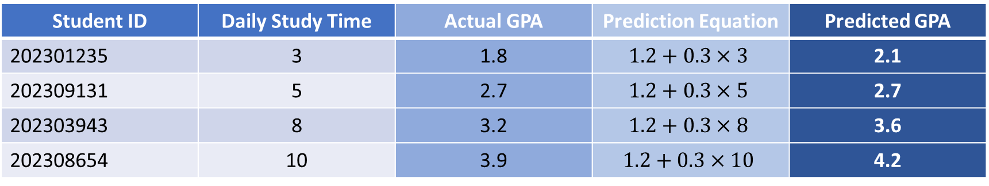

Linear Regression Example Explained
Equation: $\hat{GPA}=1.2+0.3×t_{study}$
To make prediction for a single row, replace each feature in the equation with the actual value of that feature in the row
The end result is the predicted value of the target of the row
Student ID | Daily Study Time | Actual GPA | Prediction Equation | Predicted GPA
202301235 | 3 | 1.8 | $$1.2+0.3×3$$ | 2.1
202309131 | 5 | 2.7 | $$1.2+0.3×5$$ | 2.7
202303943 | 8 | 3.2 | $$1.2+0.3×8$$ | 3.6
202308654 | 10 | 3.9 | $$1.2+0.3×10$$ | 4.2

Slide 6
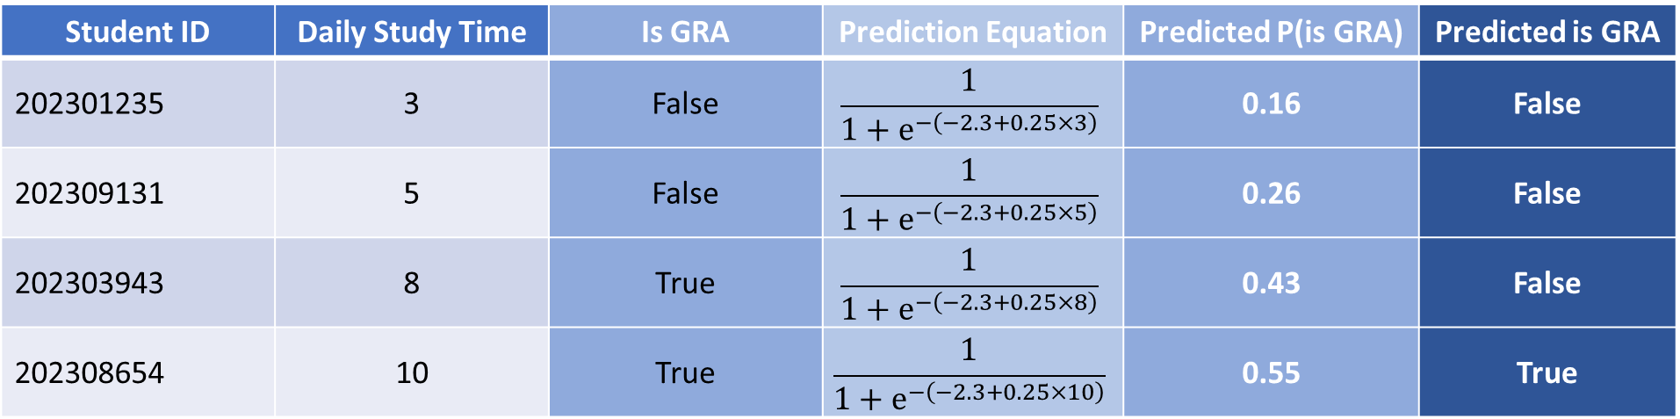

Logistic Regression Example Explained
Equation:$P\left(\hat{is GRA}\right)=\frac{1}{1+e^{−\left(−2.3+0.25×t_{study}\right)}}$
Similar like before, replace the actual value of each feature in a row to the equation to get the probability of the row belonging to the target class
Probability can then be transformed to actual class by comparing to a threshold, for example, 0.5
If $P\left(\hat{y}=1\right)≥0.5$ then $\hat{y}=1$
If $P\left(\hat{y}=1\right)<0.5$ then $\hat{y}=0$
Depends on the problem, we may want to choose a different probability threshold
Student ID | Daily Study Time | Is GRA | Prediction Equation | Predicted P(is GRA) | Predicted is GRA
202301235 | 3 | False | $$\frac{1}{1+e^{−\left(−2.3+0.25×3\right)}}$$ | 0.16 | False
202309131 | 5 | False | $$\frac{1}{1+e^{−\left(−2.3+0.25×5\right)}}$$ | 0.26 | False
202303943 | 8 | True | $$\frac{1}{1+e^{−\left(−2.3+0.25×8\right)}}$$ | 0.43 | False
202308654 | 10 | True | $$\frac{1}{1+e^{−\left(−2.3+0.25×10\right)}}$$ | 0.55 | True

Slide 7
Support Vector Machine

Slide 8
Support Vector Machine
A very famous model in Machine Learning, can be applied to both classification and regression
We begin with the simplest case of linear SVM binary classification

Slide 9




Linear SVM for Binary Classification
$$n_{lectures}$$
Let’s start with a very simple dataset
Two input features, study time and number of lecture attended
Target is binary, whether the students passed the course
And assume the instances of the two classes are separable (as in the figures)
The diamonds and circles are instances of the two classes
Diamonds are failed students
Circles are passed students
A simple strategy is to find a line that separate the two classes to make decision
But the are an infinite number of lines!
Linear SVM will tries to find an optimal line that separate the two classes
$$t_{study}$$
$$n_{lectures}$$
$$t_{study}$$

Slide 10
The Optimal Line that Separates the Classes
The optimal line that linear SVM found must
Separate the two classes
Maximize the margin between the two classes
Margin means the distances between the boundaries of the two classes
As it turns out, there is only one line that satisfies this condition
So, the solution from SVM is unique
The instances that lie on the boundaries are called Support Vectors, hence the name Support Vector Machine
Boundaries of the class
Maximized!

Slide 11

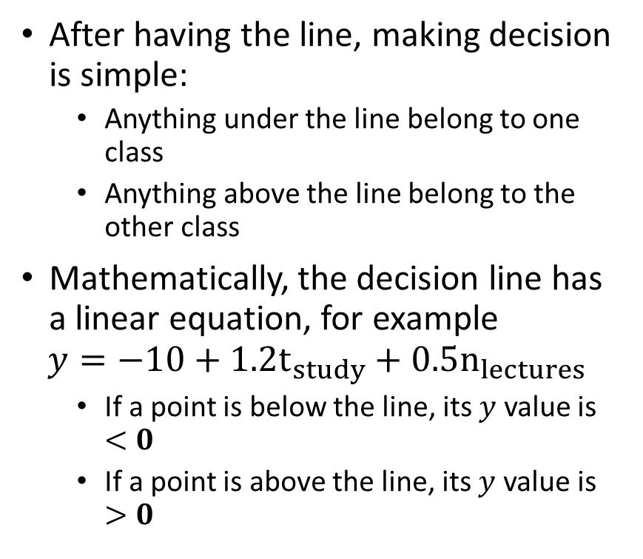

How to Make Decisions
After having the line, making decision is simple:
Anything under the line belong to one class
Anything above the line belong to the other class
Mathematically, the decision line has a linear equation, for example
$$y=−10+1.2t_{study}+0.5n_{lectures}$$
If a point is below the line, its $y$ value is $<0$
If a point is above the line, its $y$ value is $>0$
$$n_{lectures}$$
Instances in this region belong to class circle
$$t_{study}$$
Instances in this region belong to class diamond

Slide 12
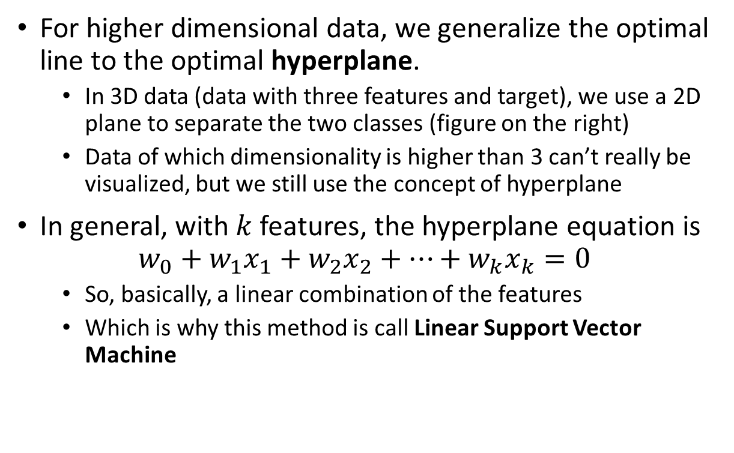
Into Higher Dimensional Data
For higher dimensional data, we generalize the optimal line to the optimal hyperplane.
In 3D data (data with three features and target), we use a 2D plane to separate the two classes (figure on the right)
Data of which dimensionality is higher than 3 can’t really be visualized, but we still use the concept of hyperplane
In general, with $k$ features, the hyperplane equation is
$$w_{0}+w_{1}x_{1}+w_{2}x_{2}+…+w_{k}x_{k}=0$$
So, basically, a linear combination of the features
Which is why this method is call Linear Support Vector Machine

Slide 13
Non-Separable Data
The data where instances are nicely distributed we used in the example is called linearly separable
And you can guess, we rarely, if ever, see them in practice
Data from real world are more non-linearly separable – instances of classes are mixed in the same areas
No linear boundary can be found
Linear SVM becomes insufficient
In such cases, we the kernel trick to obtain non-linear SVM
The new model is then called Kernel SVM
Is there any line that can separate the two classes in this case?

Slide 14
The Kernel Trick
Very roughly speaking, the kernel trick means to use something called a kernel function to transform/map data to an implicit higher dimensional space where instances of different classes suppose to be more linearly separable
This means, there are no guarantees that the kernel trick will work
And thus, we need to finetune the kernel functions
Implicit means we don’t actually know that new space to which the kernel function mapped data
Only know the instances’ similarity, represented by the values of the kernel function
We will discuss more on kernel SVM in the next module
Original Space
Kernel Trick
Higher Dimensional Space

Slide 15


Kernel Trick - Student Example
Student ID | Daily Study Time | Lectures Attended
202301235 | 3 | 3
202309131 | 5 | 7
202303943 | 8 | 11
202308654 | 10 | 15
202303453 | 4 | 9
Result
Failed
Passed
Passed
Passed
Failed
$$n_{lectures}$$
$$t_{study}$$
Higher Dimensional Space
(Actual dimensions are not known)

Slide 16
SVR – SVM for Regression
Also called Support Vector Regression (SVR)
SVM can be modified to work on regression problems
In regression, SVR find a hyperplane that minimize the margin of data – distance between the two boundaries of the instances in this case
Instances lying on the boundaries are still called Support Vectors
Target
Input Feature
Minimized!

Slide 17
Kernel Trick in SVR
Also used to map data to an implicit higher dimensional space where data is better distributed
Kernel Trick
Original Space
High-Dimensional Space

Slide 18
Tree and Ensemble Models

Slide 19
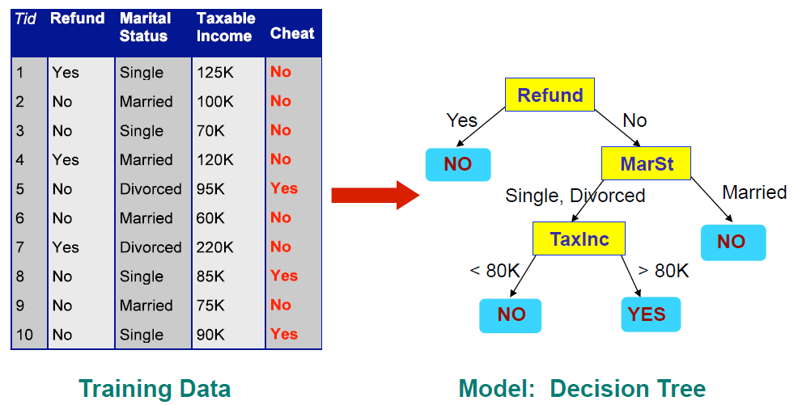
Decision Tree
Has a flowchart/tree-like representation
Each node represents a test on columns of data
Each branch represents an outcome of the node’s test
Terminal/leaf nodes decide the predicted labels of the instances

Slide 20
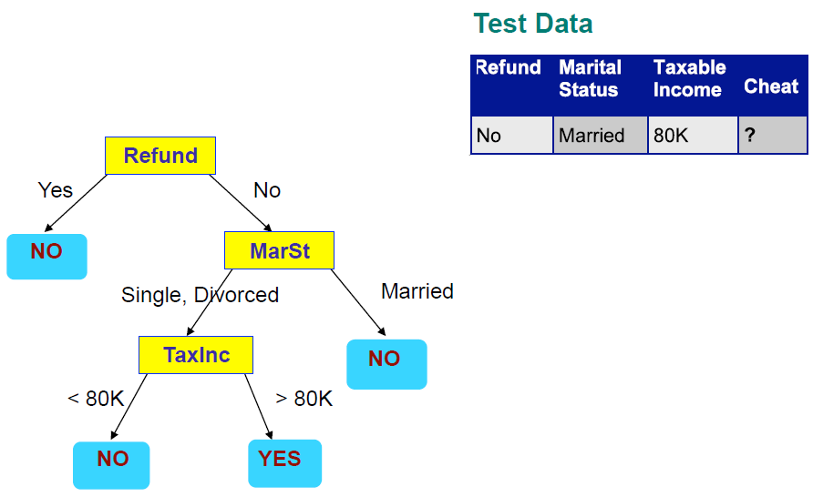
Applying a Tree to Test Data
Start from the Root Node

Slide 21













Decision Tree for Regression
Is very similar to decision tree for classification
Leaf nodes now output the predicted numeric target instead of categorical class
$$t_{study}$$
Student ID | Daily Study Time | Lectures Attended
202301235 | 3 | 3
202309131 | 5 | 7
202303943 | 8 | 11
202308654 | 10 | 15
202303453 | 4 | 9
Final grade
21
72
91
99
58
$$<5$$
$$≥5$$
$$n_{lectures}$$
$$n_{lectures}$$
$$<5$$
$$≥5$$
$$<10$$
$$≥10$$
$$\hat{grade}=20$$
$$\hat{grade}=55$$
$$\hat{grade}=75$$
$$\hat{grade}=95$$

Slide 22
Random Forest
You may have guessed from the name; a Random Forest is an ensemble model that consists of multiple decision trees
Each tree is fit/trained using a random subset of the data (in terms of both instances and features)
When make predictions, each tree generates its own predicted values. The final decision is “voted” among the trees – the value with more tree predicted wins
The use of multiple trees
Stabilizes the model
Mitigates overfitting
Improve performances in general

